Slide 1
“Piano”
Project Report
皮阿诺
2017 TAQ Honors Program In Science
Kang Xu ; Xiaowei Wu ; Yiming Liu ; Hui Meng

Slide 2
01
Introduction
02
Group Division
03
Analysis
04
Design
Catalog
05
Implementation
06
Testing
07
Result & Conclusion

Slide 3
Part One : Introduction
Our project is a program which allows you to play a simple music by pressing a particular key on the board,which 21 keys corresponds to 21 tonality and the game has two modes,one is “Playing freely mode”,the other is “Teaching mode” in which music scores will be displayed.

Slide 4
Part Two: Group Division
Kang Xu(Captain): The leader who is responsible for assigning tasks, chief planer ,taking part in all of the coding and integration of the code.
Xiaowei Wu: Part of the coding of picture(prin_key.cpp , picture.cpp, ),music file(music_little_star.cpp , etc).
Yiming Liu: Part of the coding of picture( Subfile: picture.cpp)
Hui Meng: Part of the coding (Subfile: prin_ key. cpp, sound. cpp) and PPT

Slide 5
Part Three: Analysis
Main Interface（modes choosing）
Playing Freely Mode
Teaching Mode
songs choosing
Playing Freely Mode
Make a corresponding sound after pressing the keyboard.At the same time, the keys change color.
Teaching Mode
You are given an alphabetic notation of operas. When playing the corresponding notes, the letters will change colors. Keys turns green if it is right, and keys turns red if it is wrong. Finally, it will calculate the accracy.

Slide 6
Part Four: Design
choose_picture()
start
Input x
Second_main
NO
NO
X=1 ?
X=2 ?
Printf(“default”)
YES
YES
Mode_1()
Mode_2()
end

Slide 7
Part Four: Design
Input tune
start
NO
NO
NO
……
tune=‘z’?
tune=‘x’?
tune=‘i’?
YES
YES
YES
sound
Beep(262,100)
Beep(294,100)
Beep=(1976,100)
end

Slide 8
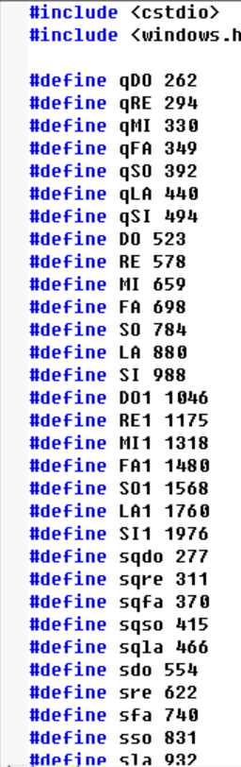
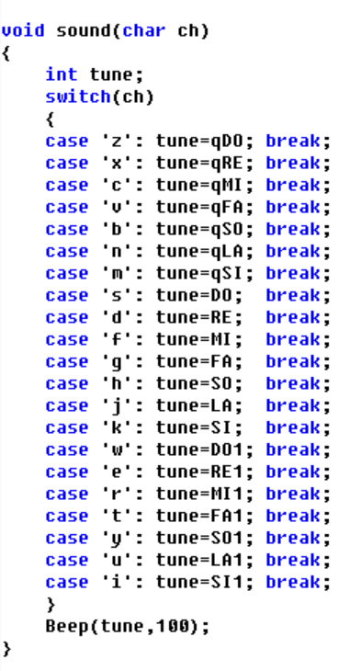
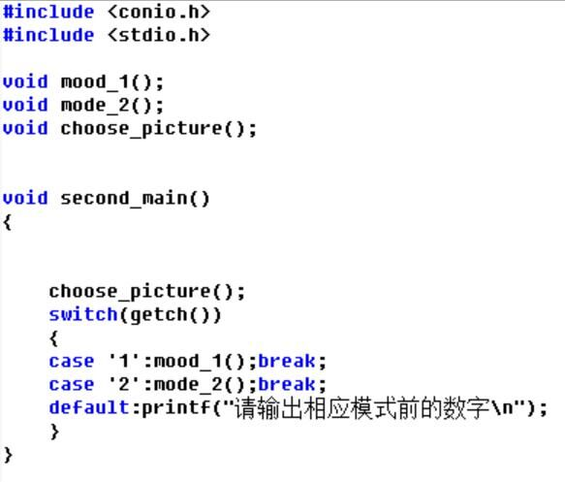
Part Five : Implementation

Slide 9
Part Six: Testing
TESTING CHART (function ”sound ”)
input | Expecting output | Real output
‘Z’ | Sound of low “Do” | Sound of low “Do”
‘J’ | Sound of “La” | Sound of “La”
‘P’ | No response | No response

Slide 10
Part Six: Testing
TESTING CHART (function ”Second_main ”)
input | Expecting output | Real output
1 | Running function”mode_1()” | Running function”mode_1()”
2 | Running function”mode_2()” | Running function”mode_2()”
3 | Output “default” | Output “default”

Slide 11
Part Seven: Result & Conclusion
Finally , the preset goals and functions have been achieved. Writing a problem is a process of constantly finding and correcting errors and seeking more optimized solution.

Slide 12
Happy new year

Slide 13

Thanks
延时符

